Slide 1

Green University of Bangladesh Department of Computer Science and Engineering(CSE)
Faculty of Sciences and Engineering Semester: (Fall , Year:2022), B.Sc. in CSE (Day)
LAB REPORT NO : 5
Course Title : Structured Programming Lab
Section : DC
Course Code : CSE 104
Student Details
Name | ID
Md. Sohan Millat Sakib | 222902036
: 13-11-2022
Lab Date Submission Date : 28-11-22 Course Teacher’s Name
: JARIN TASNIM TONVI
[For Teachers use only: Don’t Write Anything inside this box]
Marks:.....
Comments:
Lab Report Status
Signature: Date:.........

Slide 2
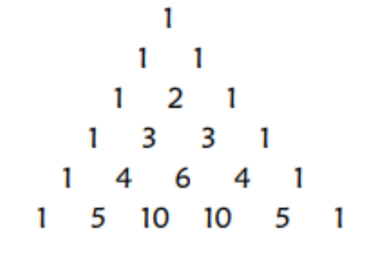
Problem 1:
Title: Display Pascal’s Triangle until a given row. For instance, if a user selects row = 6, the pascal triangle for the choice would be something like below:
Objectives:
To be familiar with scanf and printf functions.
To be familiar with logical expression.
To be familiar with the combination part of math and power function.
To be familiar with for loop.
Input & Output:
At first, we have to read a value which is the number from the user. Then the program uses some mathematical expressions to make Pascal’s Triangle.
Implementation:

Slide 3
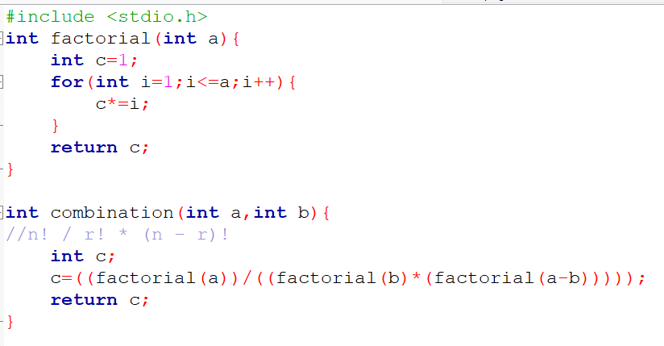
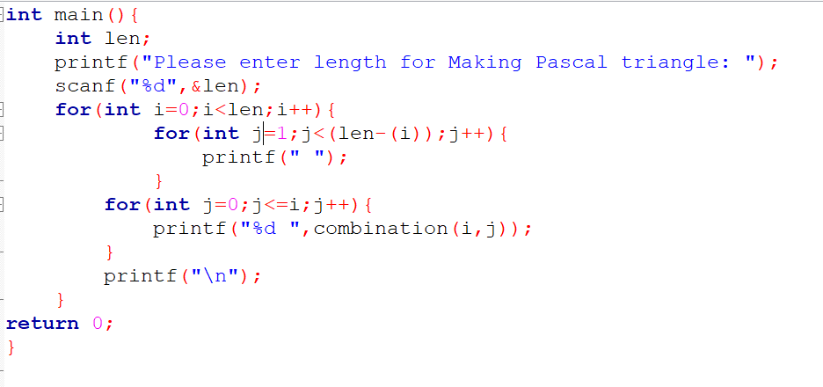
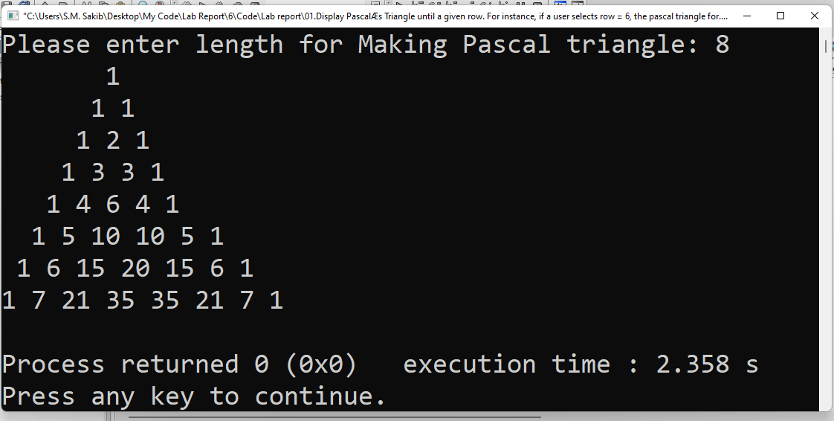
Test Result:

Slide 4
Discussion: When I write the program I have to learn how Pascal’s triangles are made..Then I apply logic and write the program…
Problem 2:
Title: Write a program in C to count the total number of duplicate elements in an array.
Objectives:
To be familiar with scanf and printf functions.
To be familiar with if else conditions.
To be familiar with logical expression.
To be familiar with array.
Input & Output:
At first, the program read the array length and array element. And count the duplicate and finally the program print the total duplicate in the array.

Slide 5
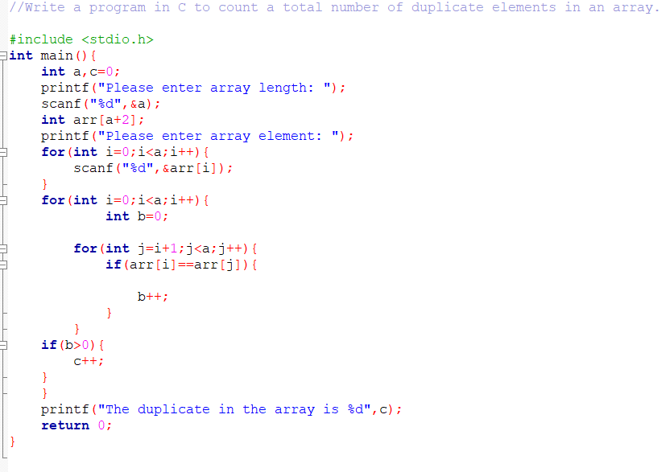
Implementation:

Slide 6
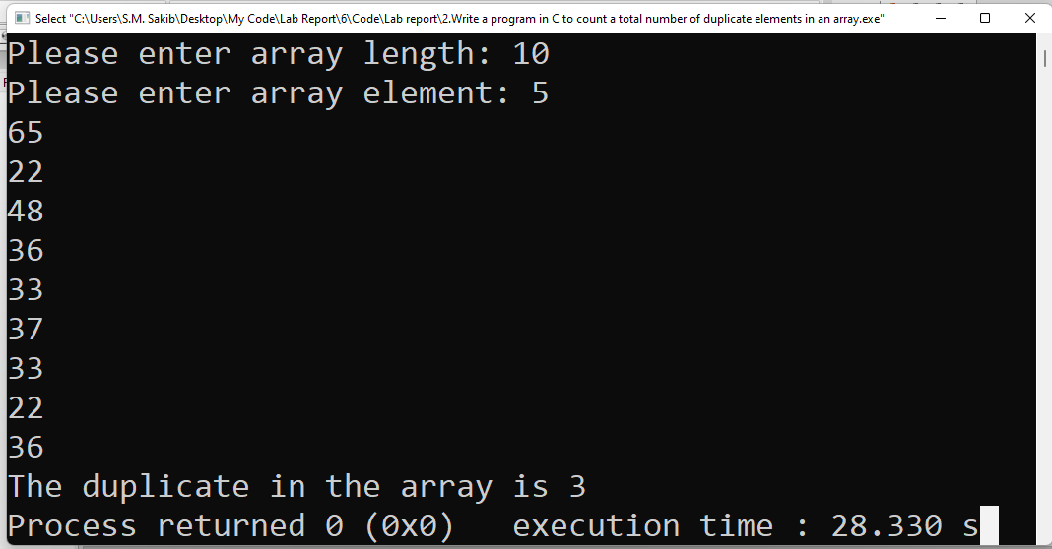
Test Result:
Discussion: When I solve the problem I don’t face any problem….
Problem 3:
Title: Write a program in C to separate odd and even integers in separate arrays.
Objectives:
To be familiar with scanf and printf function.
To be familiar with for loop.
To be familiar with if else condition.
To be familiar with array.

Slide 7
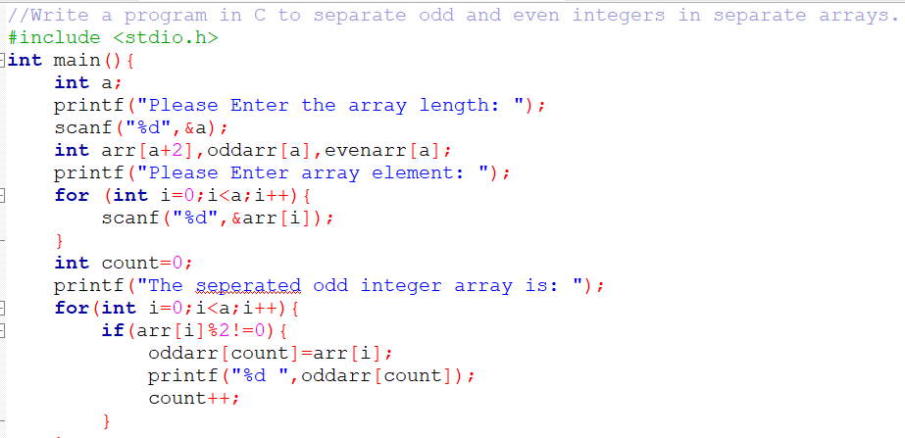
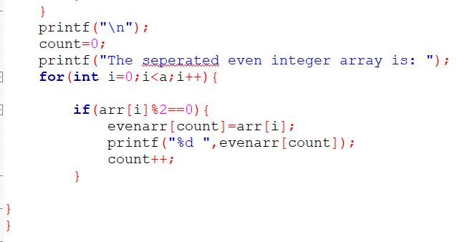
Input & Output:
This program are input the array length and array from user..Then if the number is dvide by 2 it go to even array else it go go to odd array and print it..
Implementation:

Slide 8
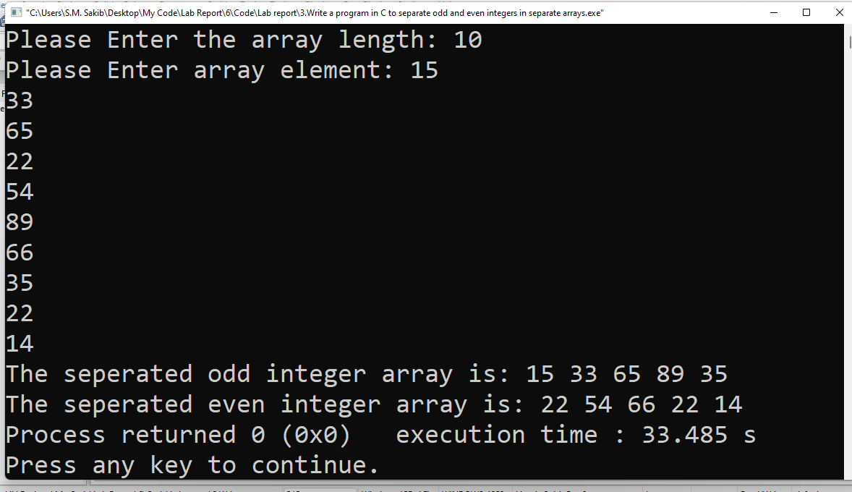
Test result:
Discussion: When I solve this programme I don’t face any problem.

